Slide 1
CONDENSATION POLYMER

Slide 2
TERYLENE

Slide 3
NYLON 6,6

Slide 4
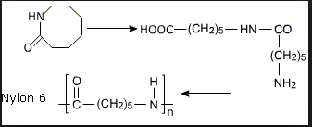
NYLON 6
Caprolactam at 533-543K with water produce Nylon6 which is used for the manufacture of tyre cords,fabrics and ropes

Slide 5
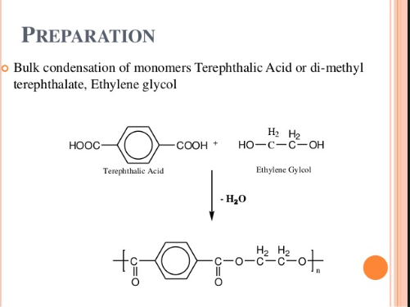
POLYESTER
Zinc acetate/antimony trioxide as catalyst
At 420 to 460 K

Slide 6
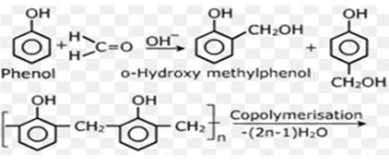
BAKELITE
NOVOLAC
Novolac on heating with formaldehyde undergoes crosslinking to form infusible solid mass called bakelite.

Slide 7
BAKELITE
USES:
Electrical switches
Handles of utensils
Phonograph records etc

Slide 8
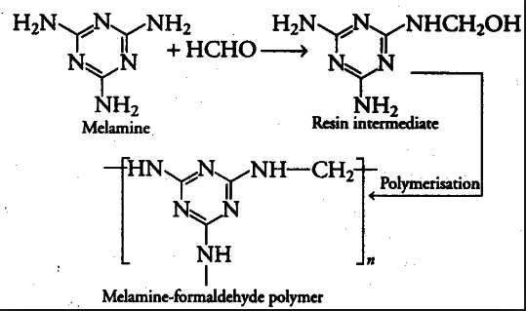
MELAMINE
Used for making unbreakable crockery

